Slide 1


K.RAMAKRISHNAN COLLEGE OF TECHNOLOGY
(AUTONOMOUS), TRICHY
LIBRARY MANAGEMENT SYSTEM
PRESENTED BY SUPERVISOR
ARUNA SHIVANI A.S Mr. M. Saravanan M.E.,
2303811710422013 AP/CSE.

Slide 2
PRESENTATION OVERVIEW
Objective
Project Introduction
Problem Statement
Methodologies (Programming concepts relevant to problem statement)
Architecture of the proposed system
List of Modules
7. Merits
8. Results and Discussion
9. Queries

Slide 3


OBJECTIVE
This Library Management System is a Java-based GUI application that allows users to manage books and users, borrow and return books, and track due dates.
It uses AWT and Swing for the interface, and ArrayLists to simulate an in-memory database for books, users, and borrowed records.
Key features include adding/viewing books and users, borrowing/returning books with due date tracking, and input validation to ensure smooth operation.
2/7/20

Slide 4
PROJECT INTRODUCTION
The Library Management System is a Java-based application designed to streamline the management of books and users in a library.
It provides an intuitive GUI for operations such as adding/viewing books, managing users, borrowing and returning books, and tracking due dates.
This project aims to simplify library operations while ensuring efficiency and user-friendliness.
2/7/20

Slide 5

PROBLEM STATEMENT
Manual library operations are prone to errors and inefficiencies, especially with large volumes of books and users.
Tracking book borrowings, returns, and due dates can be challenging without an organized system.
There is a need for an automated and user-friendly solution to streamline library management tasks effectively.
2/7/20

Slide 6

METHODOLOGIES
Requirement gathering: define the key features needed for efficient library management, including book/user management, borrowing, and due date tracking.
System design: design a gui using java awt and swing, with a logical layout and button-based navigation for easy access to functionalities.
Data management: utilize arraylists to create an in-memory database for storing and managing books, users, and borrowed records.
Input validation: implement robust input validation to handle errors like invalid ids or empty fields, ensuring smooth and reliable operations.
Testing and refinement: perform iterative testing to identify and fix bugs, optimize performance, and enhance the overall user experience.
2/7/20

Slide 7

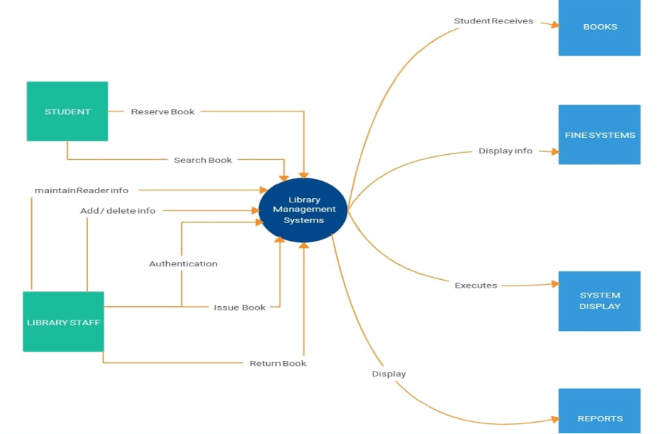
ARCHITECTURE OF THE PROPOSED
SYSTEM
2/7/20

Slide 8

LIST OF MODULES
User Management Module
Book Management Module
Add and Return Module
Issue book Module
View Book Module
2/7/20

Slide 9

MERITS
User-Friendly Interface: The intuitive GUI with organized buttons simplifies navigation and operation for users.
Efficiency: Automates time-consuming tasks like tracking books, users, and due dates, reducing manual workload.
Scalability: Modular design allows for easy addition of new features, such as search or report generation.
Error Reduction: Input validation minimizes errors in operations like borrowing, returning, and user management.
Cost-Effective: Uses Java and in-memory storage, eliminating the need for external software or database dependencies.
2/7/20

Slide 10

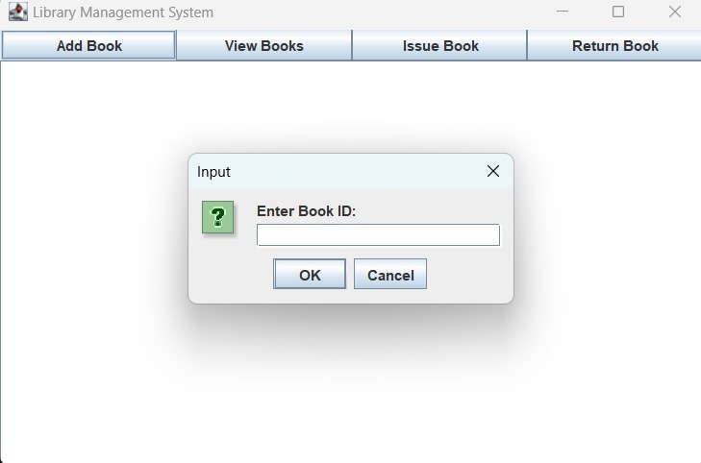
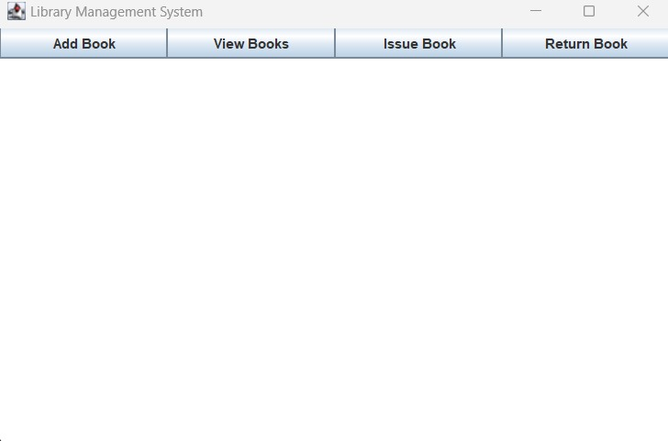
RESULTS AND DISCUSSION
2/7/20

Slide 11

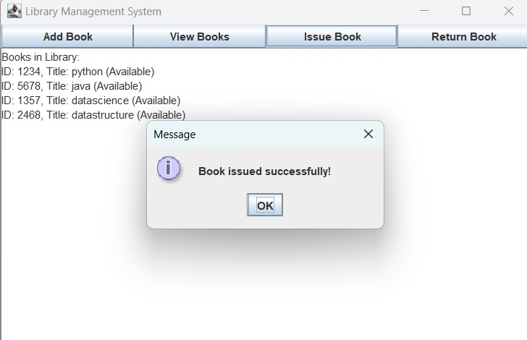
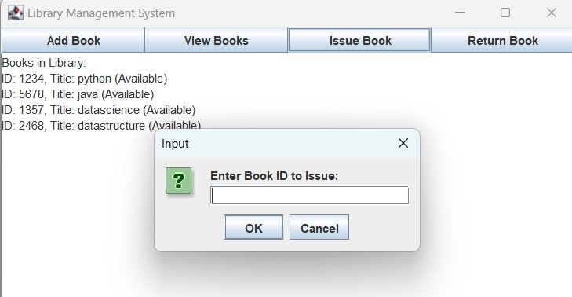
.
2/7/20

Slide 12
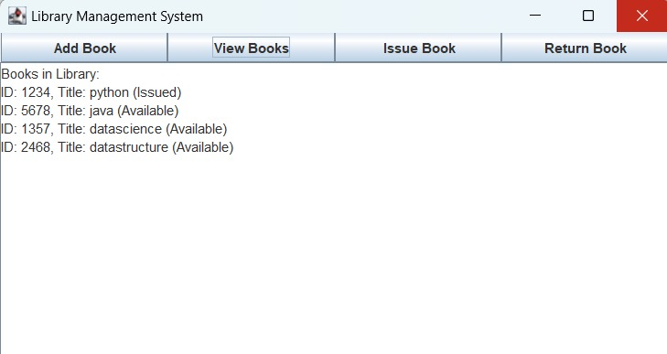
2/7/20

Slide 13
QUERIES ?
2/7/20

